Slide 1

Unlocking Argo CD’s Hidden Tools for Chaos Engineering Featuring VCluster and More
Dan Garfield & Brandon Phillips, Codefresh

Slide 2
Unlocking Argo CD’s Hidden Tools for Chaos Engineering Featuring VCluster and More
1
Intro
2
a
3
a
4
a
5
a
6
a

Slide 3



Dan Garfield
Brandon Phillips
Co-Founder &
Chief Open Source Officer
Argo Proj Maintainer
Open GitOps Co-Creator
Principal Technologist & Head of Technical Product Mktng
Host of Merging to Main
@todaywasawesome
@techieovertime

Slide 4



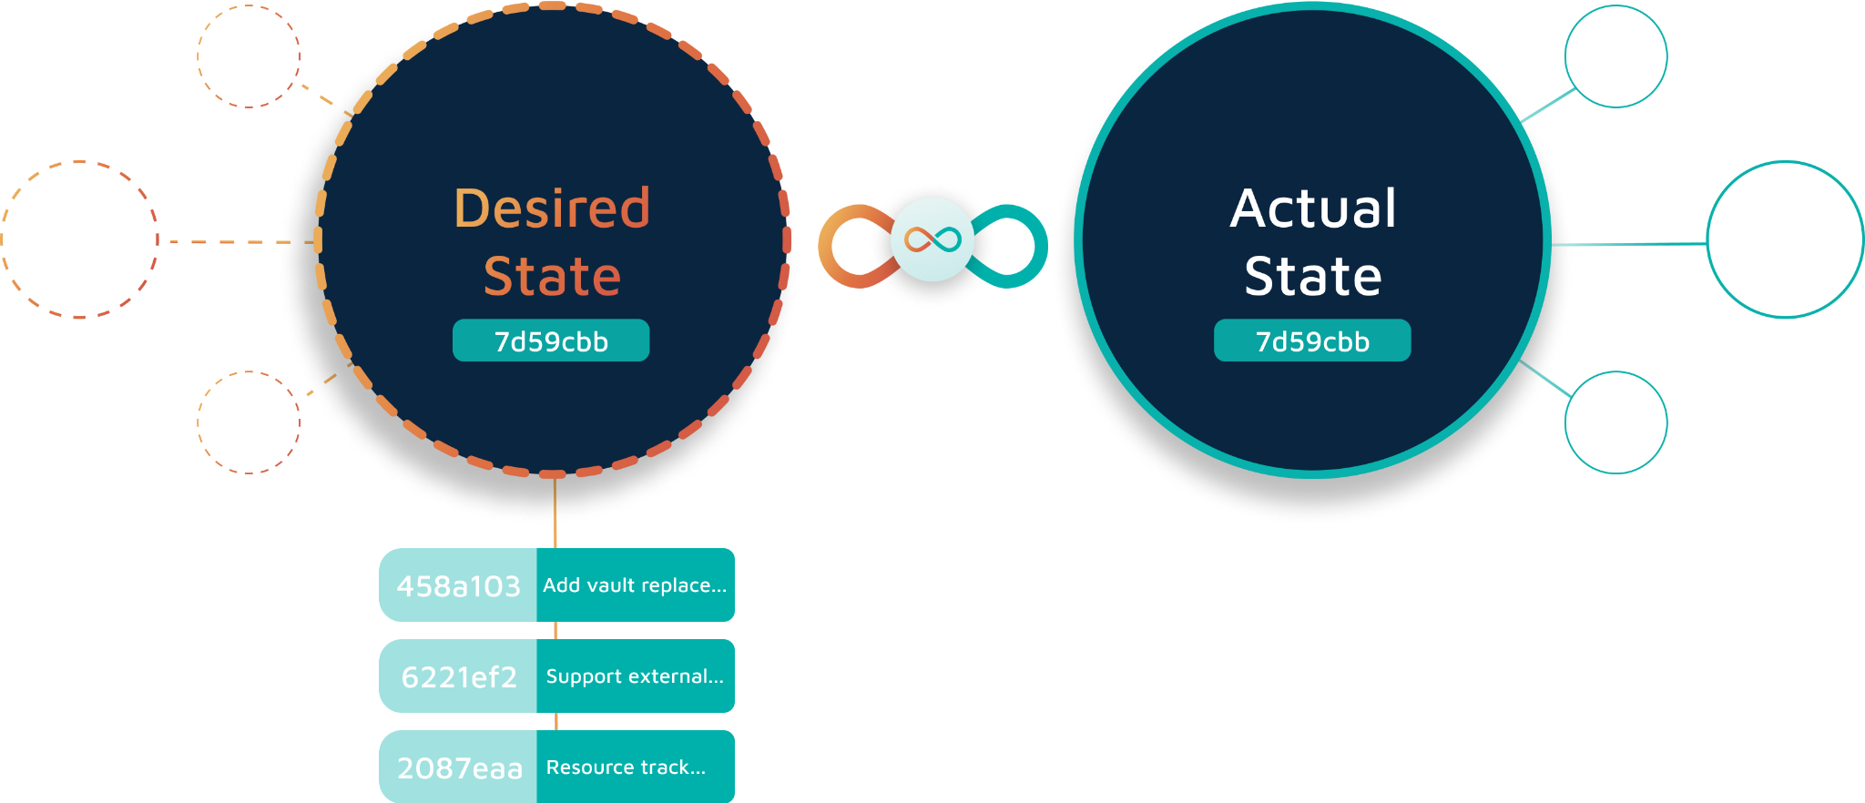
How hard could it be?
Notes:
Brandon’s Notes
How many people today are currently using Argo CD in production? [ Raise your hands ]
Talk about GitOps and demonstrating it with Argo CD

Slide 5

Lots of Kubernetes?
Notes:
Brandon’s notes
But it isn’t always that simple, what happens when you start to add lots and lots of clusters. How many clusters can you add before things start falling over

Slide 6
Or lots of Git repos?
Notes:
Brandon’s notes
And as we know, deployments don’t happen without source code. What happens when you start adding in tons of repos and developers?

Slide 7
Is one Argo instance enough?
Notes:
Brandon’s notes
Is one argo instance enough - at what point does a single instance become the bottleneck

Slide 8


Or do you need many?
Notes:
After the slide details
Brandon - “Poll for the audience of how many apps people are running on a single argo cd instance” – 1000, 5000, 10000, 15000
Dan - “Talks about a customer interaction”

Slide 9

What kind of things might you experience?
Slow reconciliation times
Template rendering times continue to increase
Client-side web UI unresponsiveness
This is fine..

Slide 10

Introducing Gen Resources
github.com/argoproj/argo-cd
Notes:
Brandon’s notes
So we have a free tool called gen resources, Dan where can we find that at

Slide 11

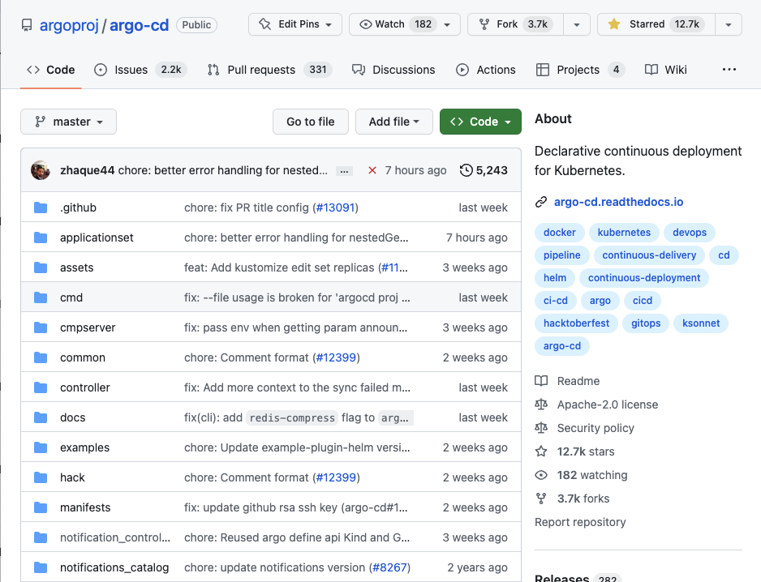
SECRET IN PLAIN SIGHT!

Slide 12

Gen Resources Creates
Clusters
Apps
Projects
Repos
D E M O T I M E
Notes:
Demo:
Build gen resources
While it’s building
Show Argo instance
Show prometheus dashboard
Show values file and explain how they each work
Show slide with cluster stats
Come back and fire off resource generation
Monitor Prometheus and Argo Dashboards
Spend some time showing Prometheus metrics and which ones are important

Slide 13
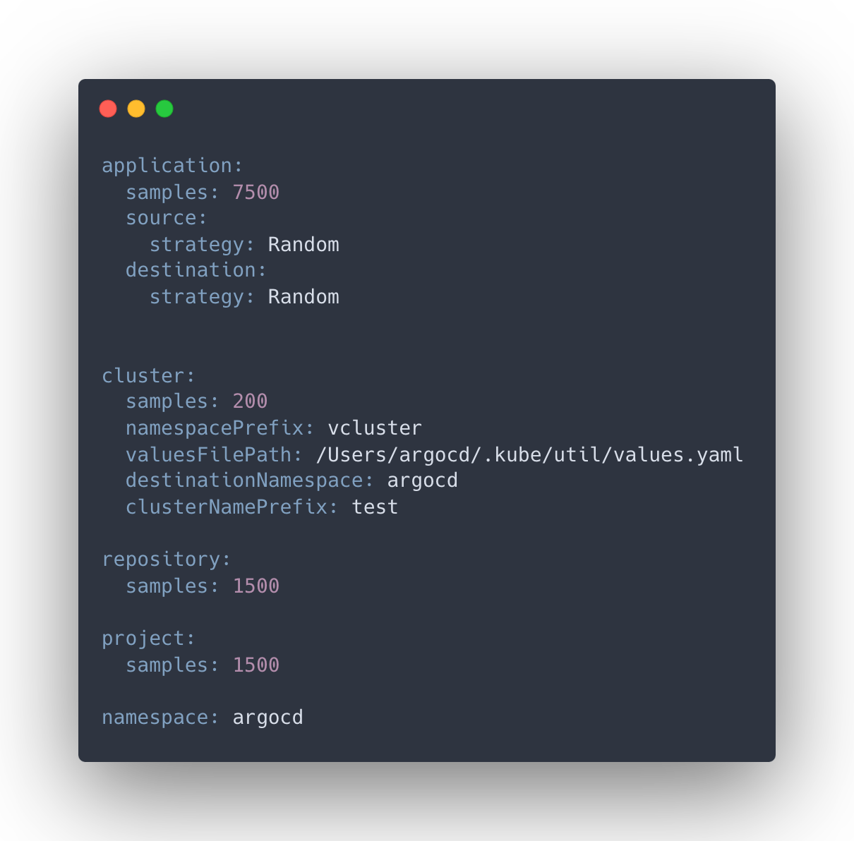
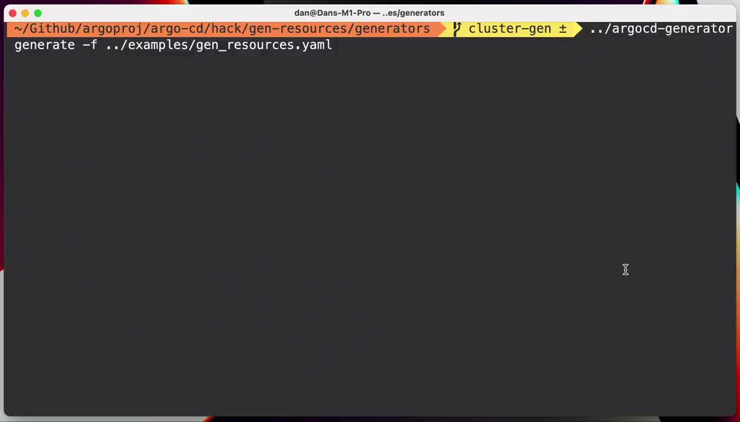
Modeling for Performance

Slide 14


Slide 15
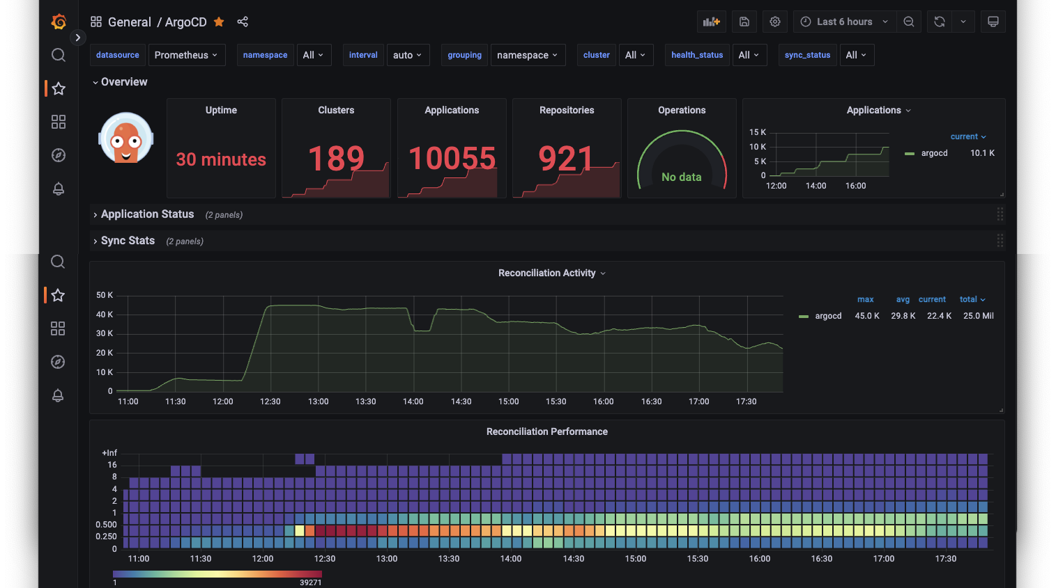
Argo CD Performance Scales Very Well
1k apps
2.5k apps
5k apps
7.5k apps
10k apps

Slide 16
General Rules
Rule of thumb
Conservatively, expect at least
~1.5k apps,
~ 14k objects,
~50 clusters,
~200 devs,
whichever comes first.
Tested using Argo CD HA w/default settings.
GKE - e2-standard-4 nodes 4 vCPU x 16GB
With tweaking, you can go far beyond.

Slide 17
More on Scaling Argo CD
Performance
Security
Organization
codefresh.io/blog/
scaling-argo-cd-securely-in-2023/
codefresh.io/blog/a-comprehensive-overview-of-argo-cd-architectures-2023/

Slide 18

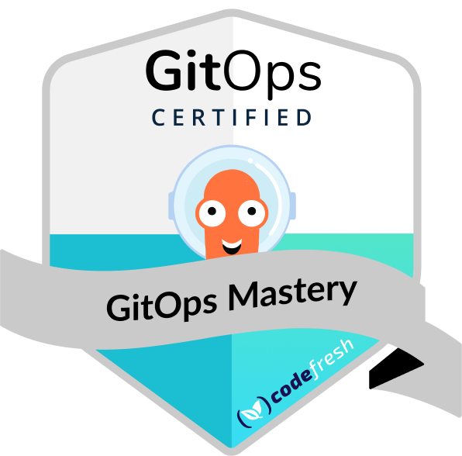

GitOps with Argo Certification and Training
#1 GitOps Certification
Over 18k students!
Learning.codefresh.io
Code: MELOVECHAOS
Code: MESLOWCHAOS

Slide 19










THE SECRET IS OUT
Join Sig-Scalability
#argo-sig-scalability in CNCF slack.

Slide 20





SPECIAL THANKS TO MIDJOURNEY FOR
THE ARGONAUTS

